Slide 1






CISC3003
Travel Web
Presented by: TEAM 5
Li Shitian DC126892
Wu Xinrui CC029577
Wang Hao DC127253
Xiao Yuanze DC127823
Chen Yiran DC126808
Ao Chikin DC126400

Slide 2



Introduction
Travel website
Interactive travel website： Exploring global landmarks, booking attractions, and participating in community discussions
Tools
HTML, CSS, Javascript, Docker, MySQL (probably ),PHP

Slide 3


Forum and Login Page
Introduction
In today's digital age, personalized travel web forums have become an important platform for travelers to share their travel experiences and comments. Our proposal aims to add a forum section to your personalized travel web page, providing a space for users to communicate, share and interact. The forum will provide a platform for users to share their travel experiences, exchange travel experiences, and provide reviews and recommendations on travel destinations. And also add a Login page for user.

Slide 4





Login - Key Features
General Login Function
Support username and password input
new user register and forget password function
Forum Validation
Perform front-end validation before the user submits the login form to ensure form completeness and correctness:
Validate the format and validity of the username/email address.
Validate password complexity requirements, such as minimum length and inclusion of letters and numbers.
Error handling and user feedback
Display an appropriate error message on the login page so that users are aware of any errors that occur during the login process.
Provide friendly user feedback, such as automatically redirecting to the user's profile page or displaying a welcome message after successful login.

Slide 5

Methodology - Login
Page layout and appearance
Front-end verification
Back-end processing

Slide 6
Map Pin and landmark details
Introduction
The website will engage users by providing a visually appealing homepage featuring a large, interactive world map with clickable pins representing each continent. And based on continent, explore the famous sights, details, and travel prices of different continents!

Slide 7
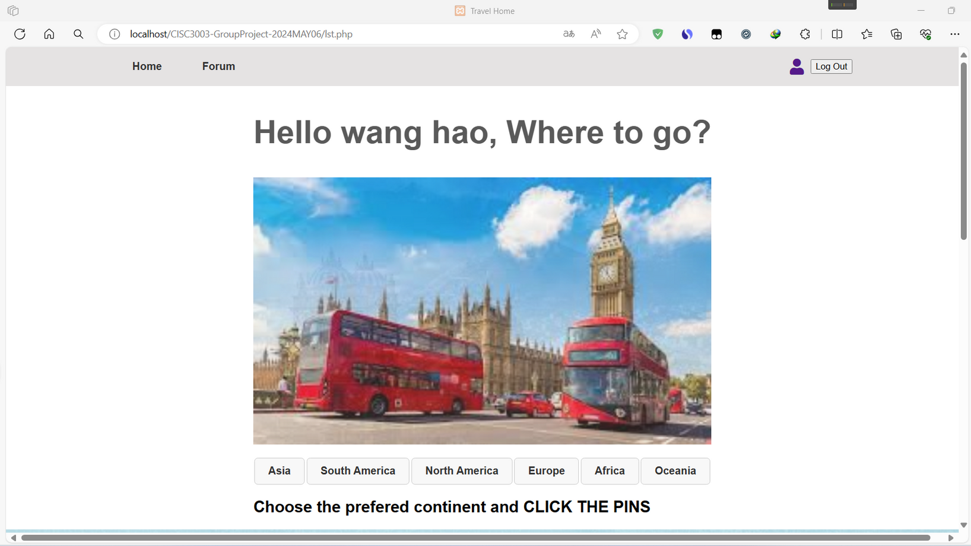
Home Page

Slide 8
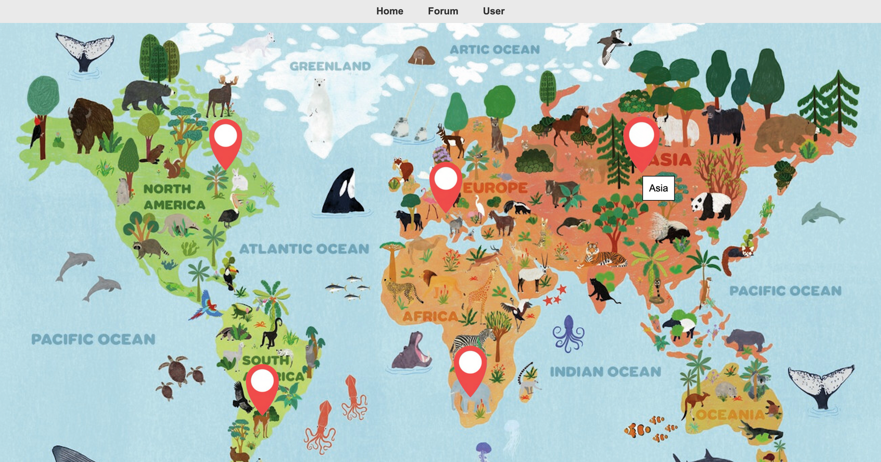

Feature: Click on Map
Five continents
Five clickable map pins
Three links on header,
for more features ...
Source code of PINS：

Slide 9

CLICK ASIA!

Slide 10
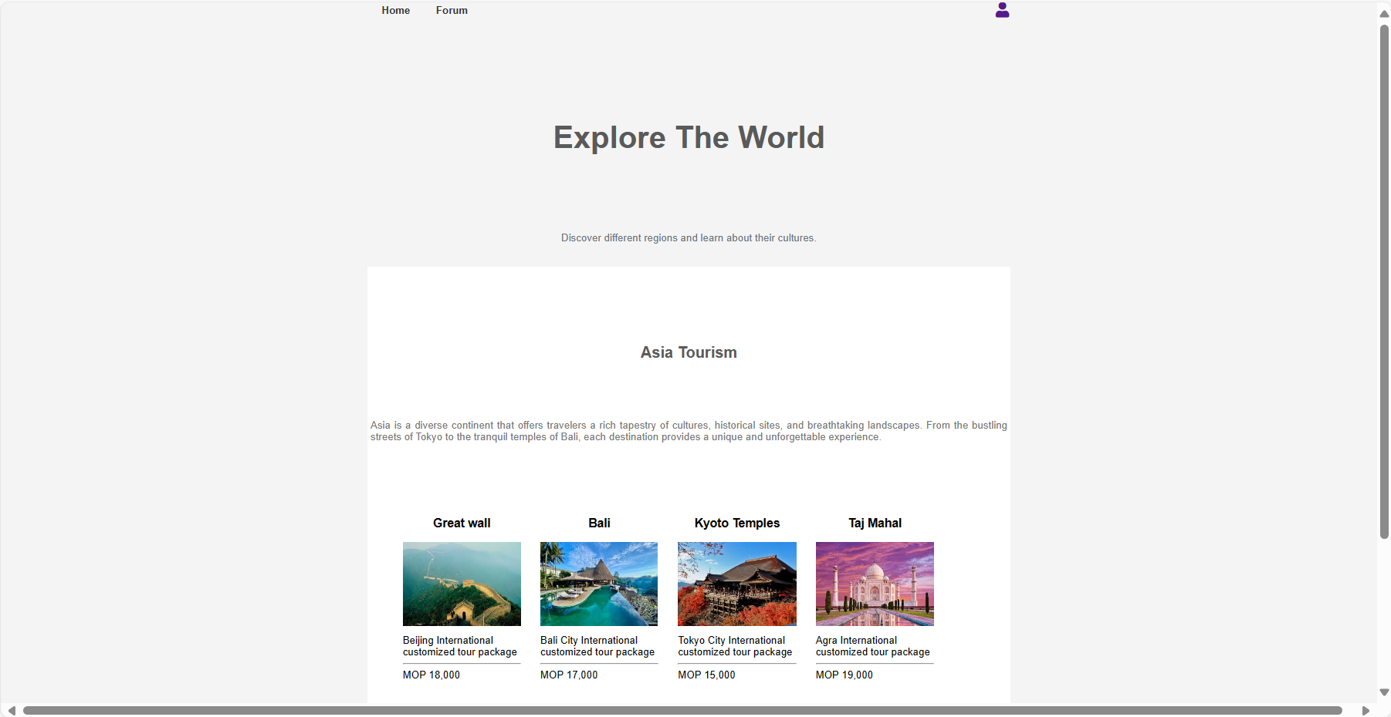

Slide 11
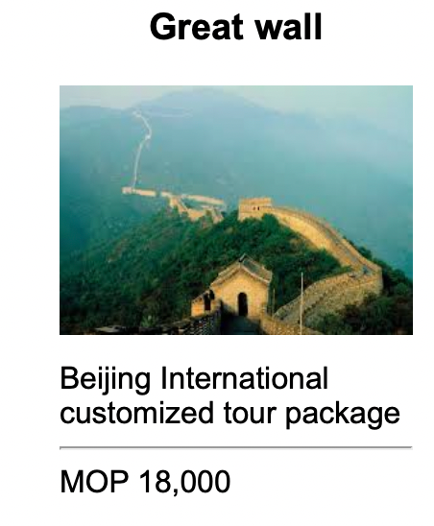
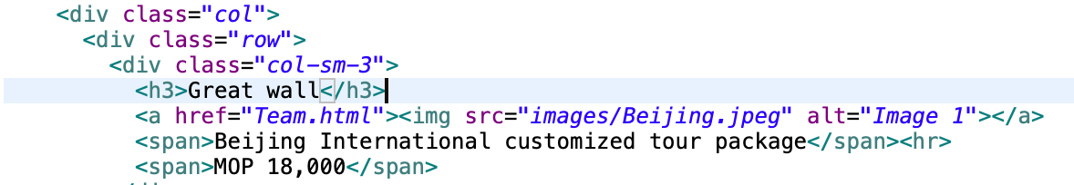
CLICK THE IMAGE
JavaScript code changes the opacity of images on hover for visual feedback
SOURCE CODE:

Slide 12
Attraction Rating and booking module
Introduction
Our Attraction Rating and Booking Module offers a streamlined experience for travelers to rate and book attractions effortlessly. Users can explore attractions, read real-time reviews, and make bookings directly through the module. This integrated approach simplifies the decision-making process and enhances the overall user experience, making it easier to plan and enjoy your trip.

Slide 13





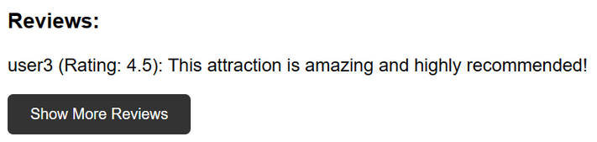


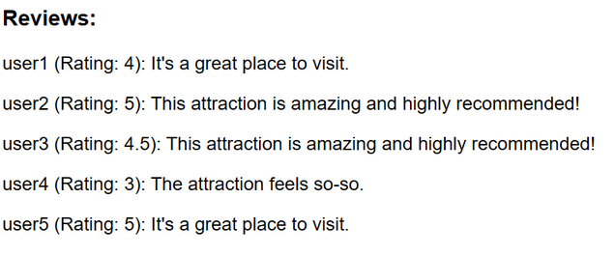
Attraction Rating
User ratings and reviews
Screening system
Users can rate and comment on different attractions, and finally we will get the total rating of the attraction based on the average rating of users.
Filter different attractions by selecting tag from all seven continents.
Review
According to the user's ratings, the reviews that are closest to the average rating are selected as a display. Users will still be able to view other comments.

Slide 14





Booking
01
02
03
Select your desired attraction and click to enter the booking page.
Fill in your personal information and click "Book Now."
Confirm the payment amount and select the appropriate payment method to proceed with the payment.
Notes:
The booking page is used to allow users to book the attraction. To book the desired attraction, you just select it and click to access the booking page. Once there, you'll need to fill in your personal details. After entering your information, click on the "Book Now" button. You'll then be asked to confirm the payment amount. Choose the appropriate payment method and proceed to complete your payment.

Slide 15
Forum Page
Introduction
In today's digital age, personalized travel web forums have become an important platform for travelers to share their travel experiences and comments. Our proposal aims to add a forum section to our personalized travel web page, providing a space for users to communicate, share and interact.

Slide 16
Forum - Key Features
Topic Reading
Users can get detailed descriptions of attractions, which are stored in SQL.
Post and reply
Users can post their own travel experiences, recommendations or questions, and respond to existing posts or topics.
Tagging and categorizing
The Forum supports tagging and categorizing of posts, enabling users to easily browse and filter content on specific topics or types.

Slide 17
Methodology - Forum
Front-end (HTML, CSS,JavaScript)
Create a publishing subject form:
Create a form in HTML that contains input fields to enter the subject title, content, and related information.
Use CSS to design and lay out forms so that they are user-friendly and easy to use.
Create a list of posts and topics:
Create a list of posts and topics using HTML and CSS to display the posts and topics that have been published. Each post should include information such as title, author, and date.
Use JavaScript to dynamically fetch and display a list of posts and add click events to each post so that users can view the details of the post.

Slide 18
Methodology - Forum
Front-end (HTML, CSS,JavaScript)
Implement post and reply functions:
Create a post and reply form in HTML with input fields to enter the content and related information.
Use JavaScript to handle form submission events and send user input to the back end for processing.
Implement labeling and classification functions:
Add a tag and category selector to the HTML page, allowing users to select the tags and categories that apply to their posts.
JavaScript is used to process the user's selection and send the selected label and classification information to the back end.
Back-end (PHP SQL Database)
Server-side language: Choose a server-side programming language, such as PHP for handling user requests, data storage, and business logic. Database: Use an appropriate database MySQL to store user profiles, post content, and other relevant data. API Design: Design and implement back-end apis to handle front-end requests and data interactions, such as saving and obtaining user profiles, acquiring and submitting post content, etc.

Slide 19
Projct Conclusions
The project delivers an engaging travel website that guides travelers, educates users on cultural and historical landmarks, and facilitates travel planning and community interaction through booking functions and user forums. This comprehensive approach inspires wanderlust and expands awareness of the world's beauty and diversity.

Slide 20

Thank's For Watching

